Slide 1


DC Motors
Making things move
Keith Chester
@thekeithchester
https://github.com/hlfshell/DC-Motors---Making-Things-Move

Slide 2


Who am I?
Degree in Robotics Engineering
Runs Hardware Projects for Fusion Marketing
Programmer
Friendly neighborhood maker
Organizer of node.jSTL, jSTL, Code for the People
hlfshell
https://stltech.herokuapp.com
keithchester
thekeithchester

Slide 3
What are we covering?
Brushed DC Motors
Controlling Motors
Servo Motors
Torque
Positional Feedback
Stepper Motors
Brushless DC Motors
Calculating what motor we need

Slide 4
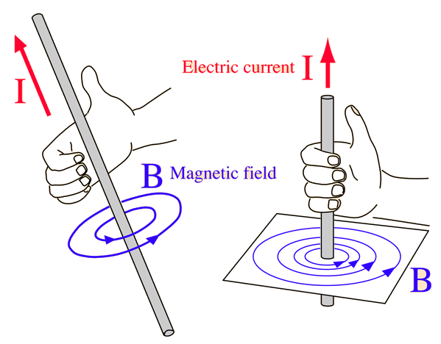
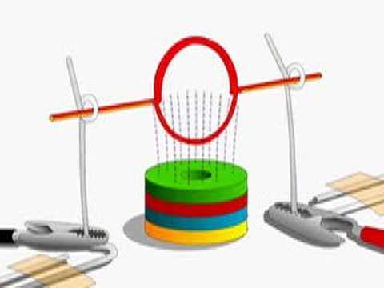
The core concept - the simplest little motor

Slide 5
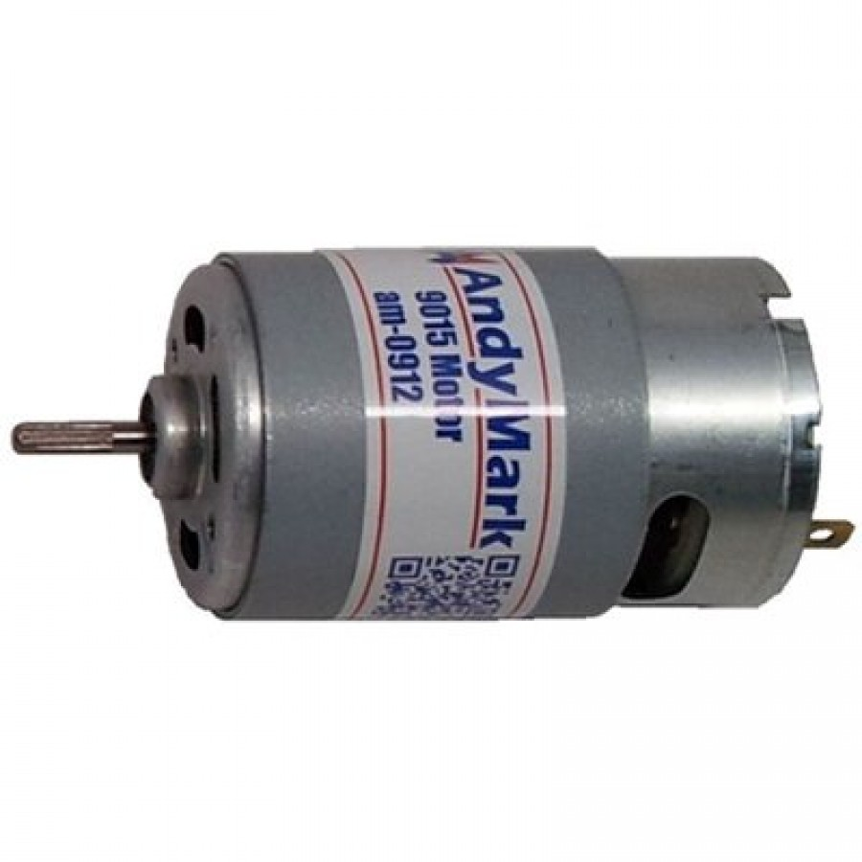
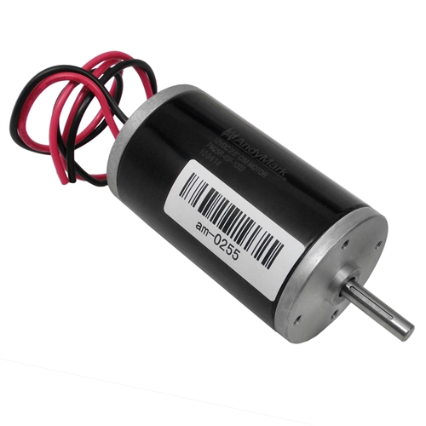
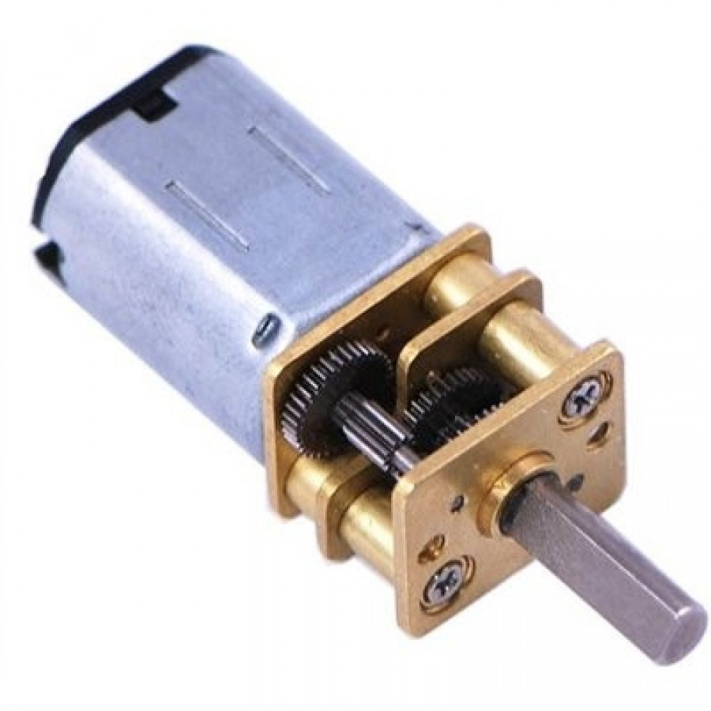
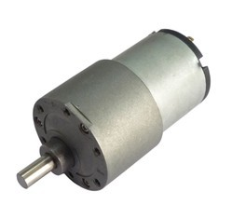
Brushed DC Motors

Slide 6
Brushed DC Motors
PROS
Easy to control
Easy to manufacture and thus cheaper
Very common
CONS
Limited total lifespan or required maintenance due to brushes
Not as efficient

Slide 7
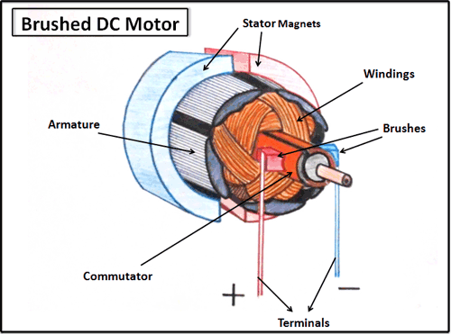
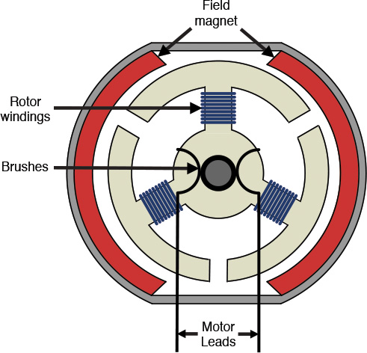
Brushed DC Motors - structure

Slide 8
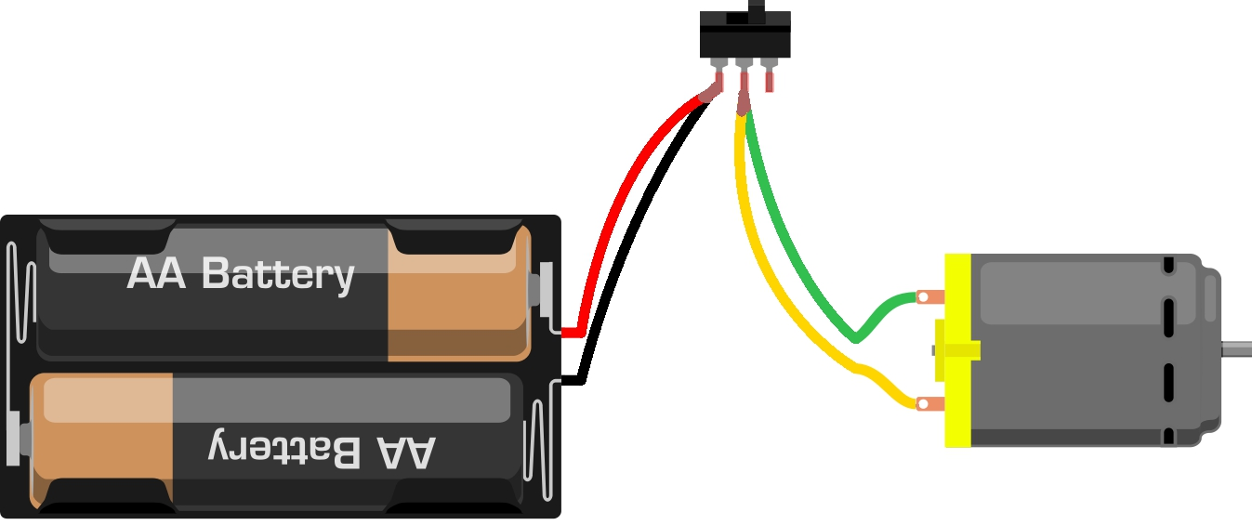
Controlling DC Motors - simple

Slide 9
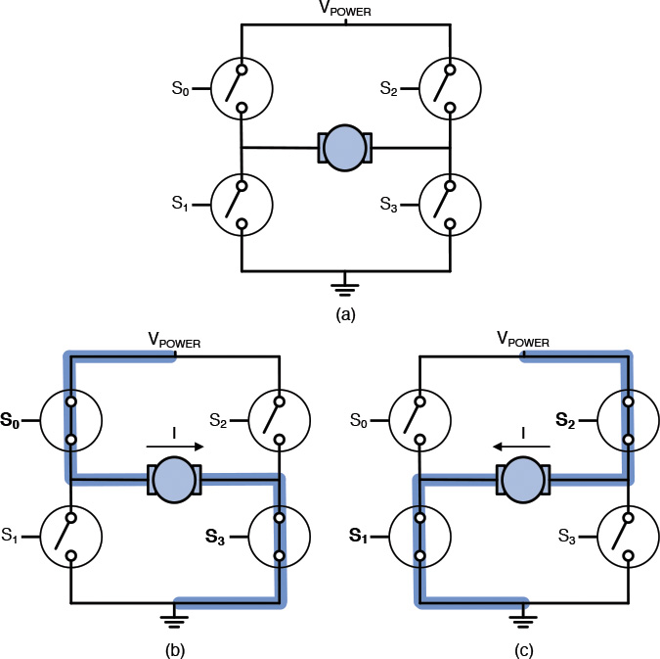
H-Bridges
Motors For Makers
Matthew Scarpino

Slide 10
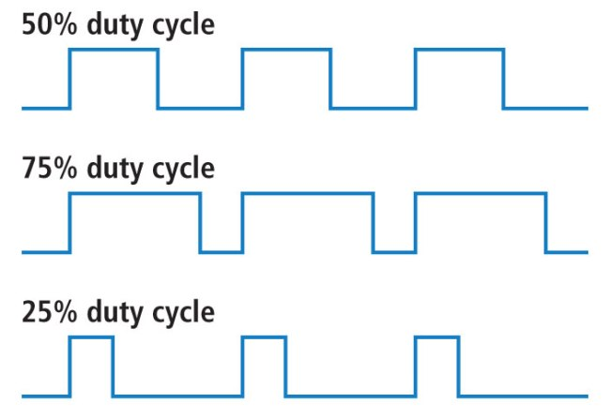
Pulse Width Modulation (PWM)
12V
~6V
0V
12V
~9V
0V
12V
~3V
0V

Slide 11
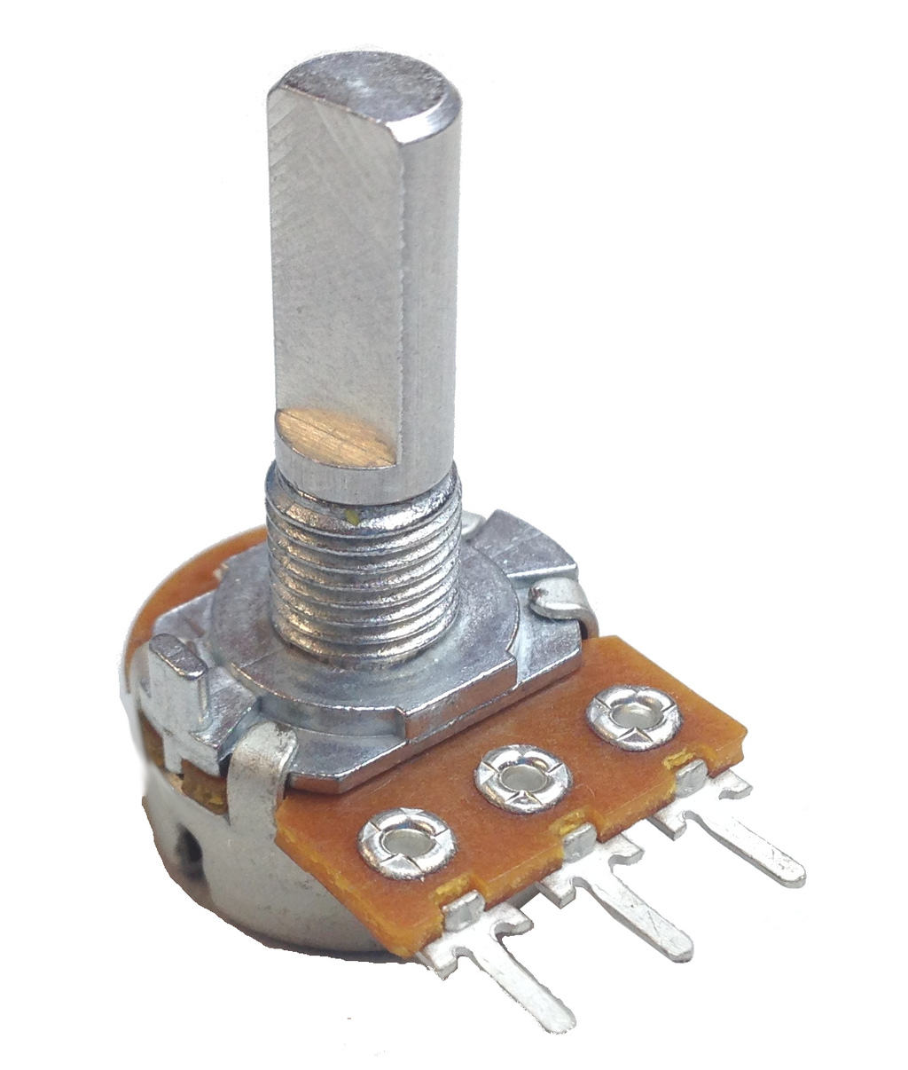
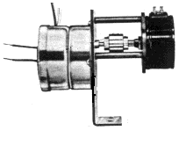
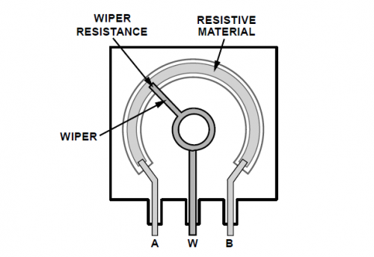
Positional Feedback -Potentiometers

Slide 12
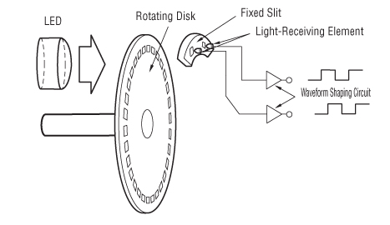
Positional Feedback - Encoders

Slide 13
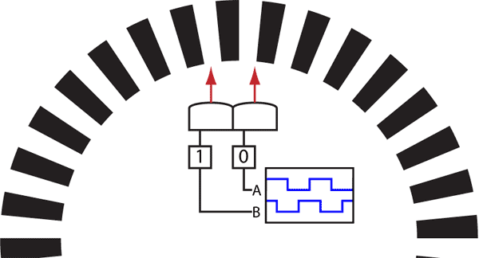
Quadrature Encoders

Slide 14
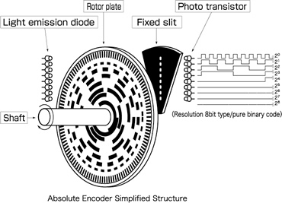

Absolute Encoders

Slide 15
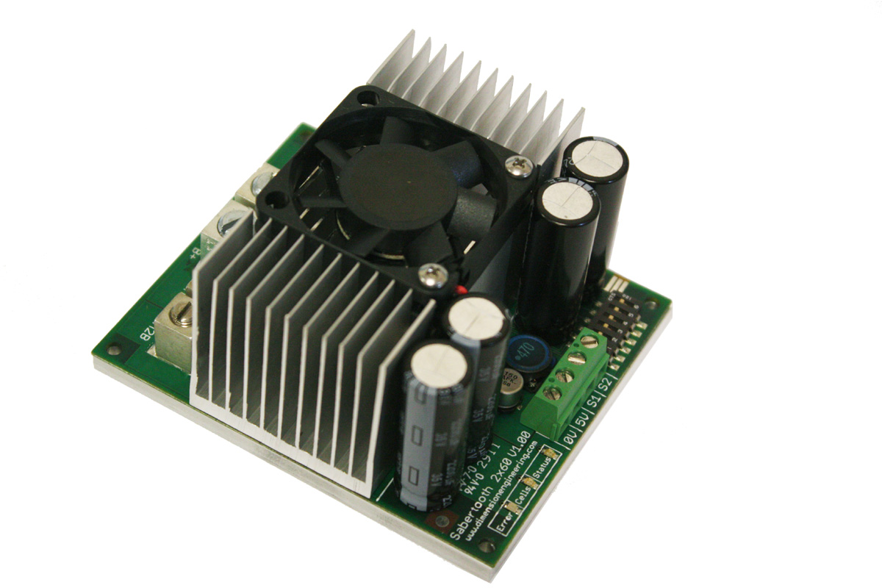
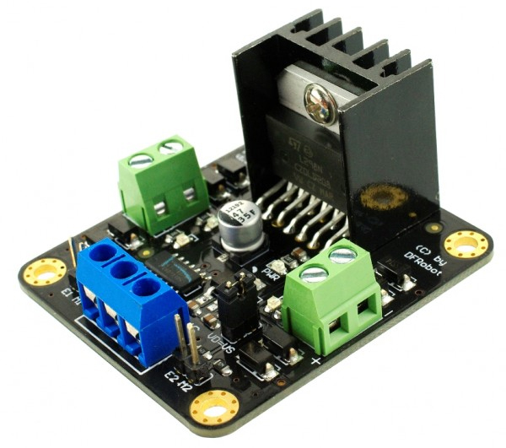
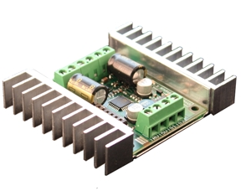
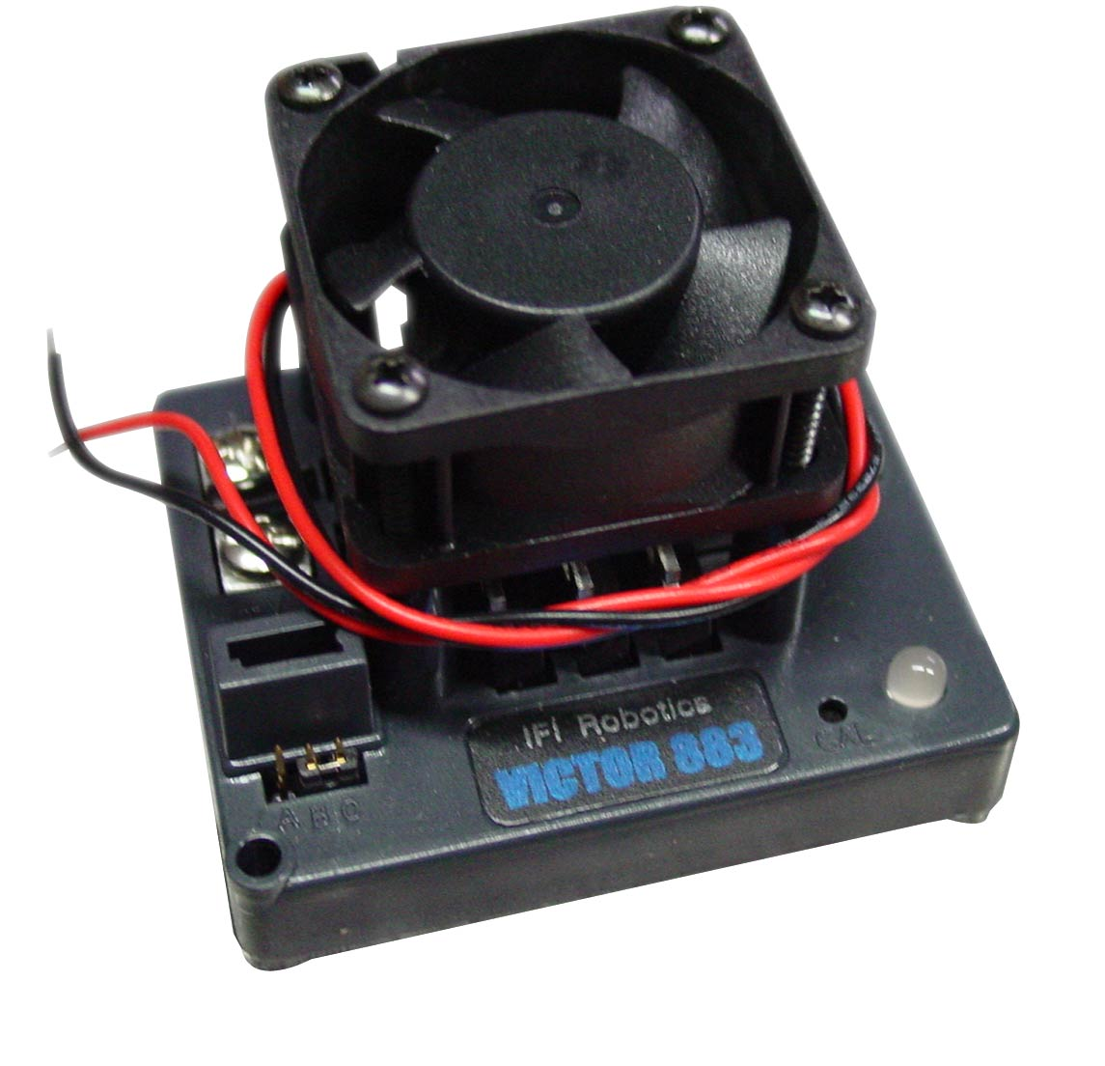
Motor Controllers

Slide 16
Servo
noun - sərvō -
An electrical motor with integrated positional feedback and control systems

Slide 17
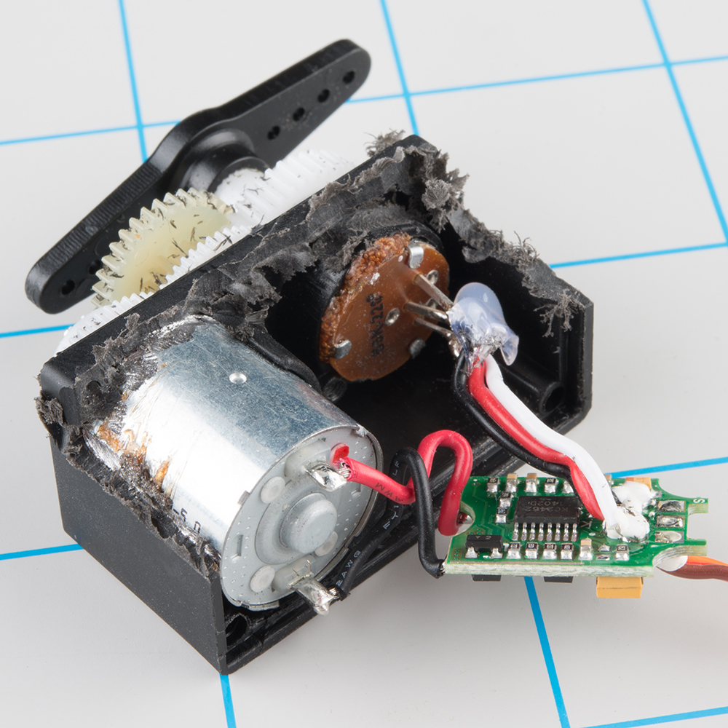
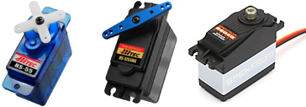
Hobby Servos
from Sparkfun

Slide 18
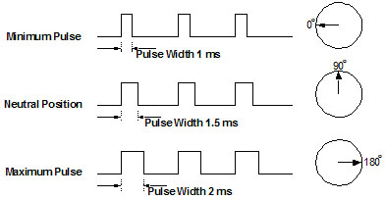
“Servo signal”

Slide 19
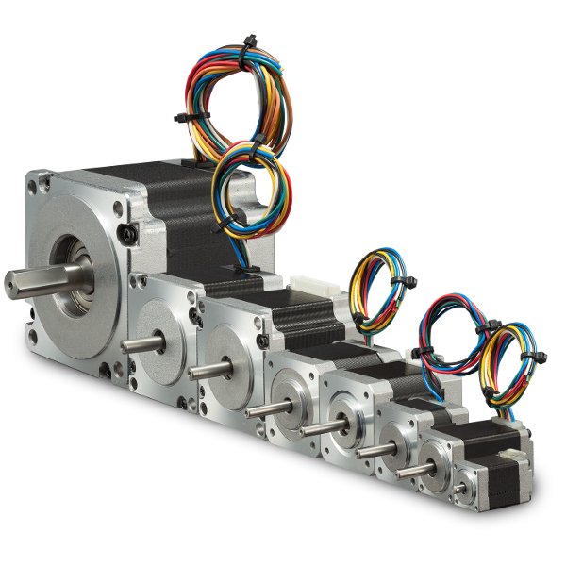
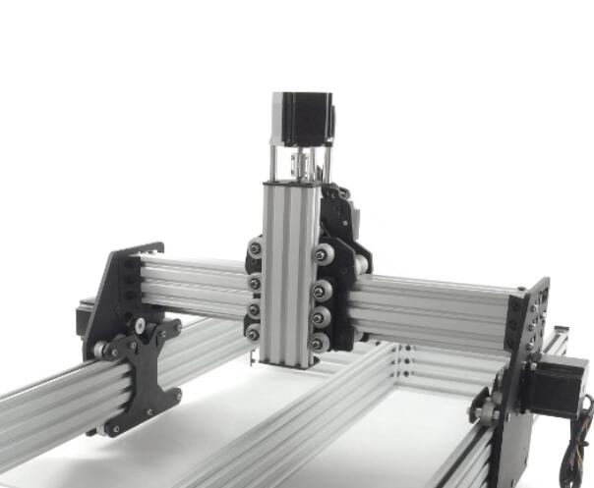
Stepper Motors

Slide 20
Stepper Motors
PROS
Precision Movement Control
Easy to control movement
Cheap due to 3d printers
CONS
“Holding” torque takes tons of current
Not fast or as torquey to equivalent weighted motors
“Dumb” without additional sensors still

Slide 21
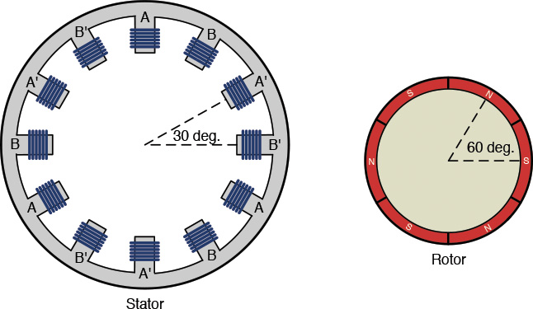
Stepper Motors - Structure
Motors for Makers

Slide 22
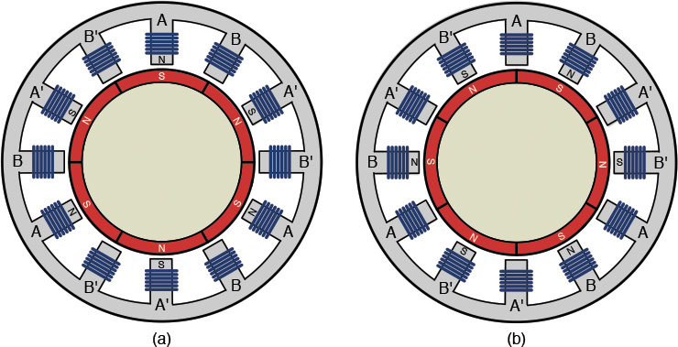
Stepper motors - “pulses” = “steps”
A is positive
A’ is negative
B is positive
B’ is negative

Slide 23
Stepper Motors - step types
Full Step One Phase - what we just covered
Full Step Two Phase - both phases are on, motor goes between windings. Twice as much current, 30-40% more torque
Half Step - Alternates between one and two phase activations - half the step angle, 20% less torque
Microstep - Current is delivered in a sinusoidal wave, reducing step size to a tiny fraction of original. Smoothest possible motion. 30% torque reduction and slower

Slide 24
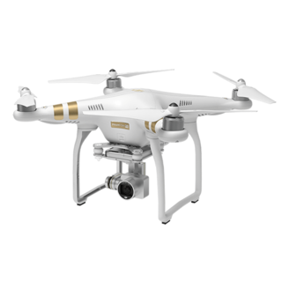
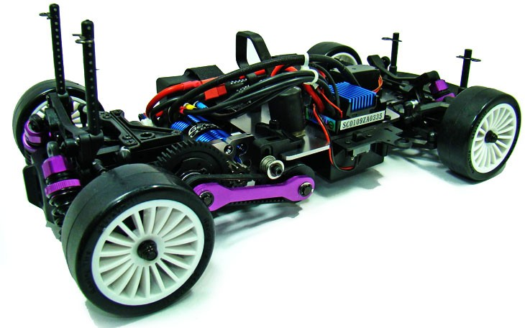
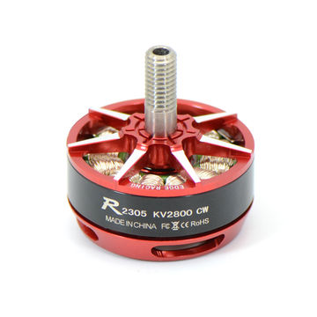
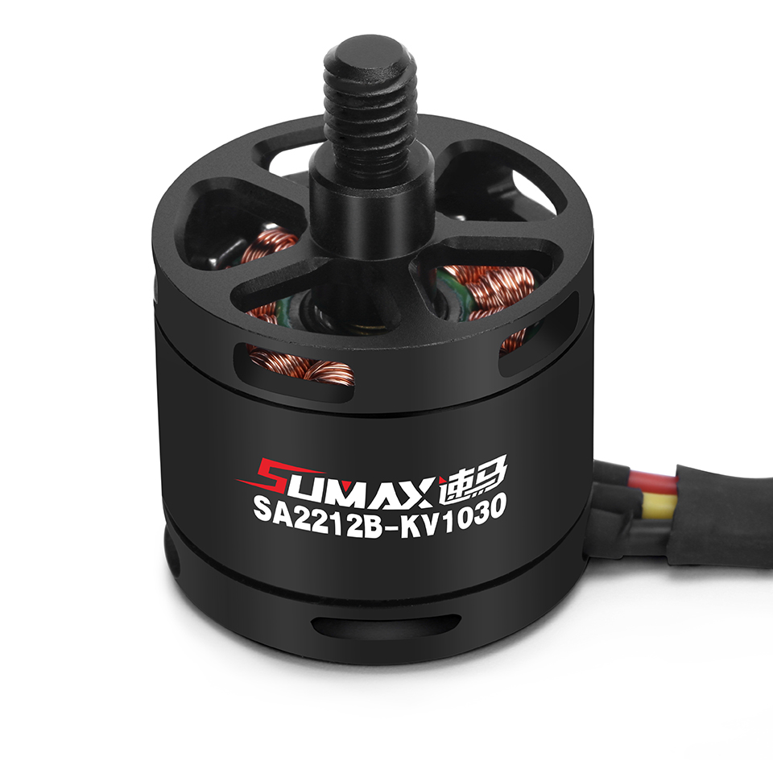
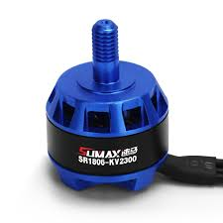
Brushless DC Motors - BLDC

Slide 25
Brushless DC Motors
PROS
High speed and high torque
Far less maintenance / longer lifetime
More efficient
CONS
More complex to control
Higher price, though dropping

Slide 26
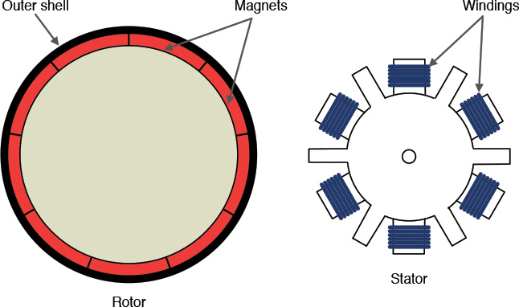
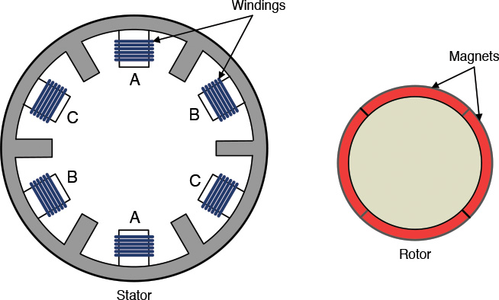
BLDC - structure
* Three phase motors
A
C
B
B
A
C
Outrunner BLDC
Inrunner BLDC
Motors for Makers

Slide 27
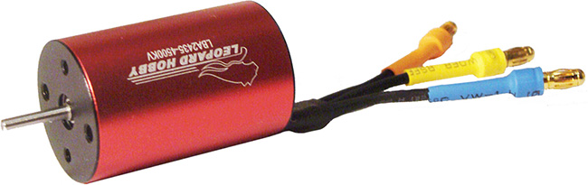
Inrunners vs Outrunners
Inrunners - very high speed - very low torque
Outrunners - very high torque, used in drones/remote control cars

Slide 28
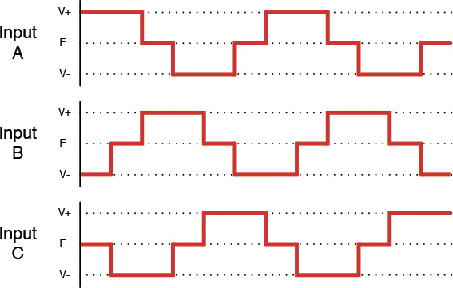
BLDC - Controlling BLDCs
6 steps- 360 degrees
1 step - 60 degrees
Orientation of the motor matters for the phase

Slide 29
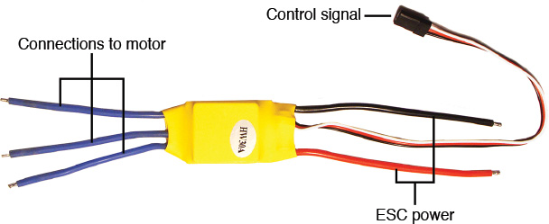
ESCs - Electronic Speed Controllers

Slide 30
Programming ESCs
Auto-cutoff
Brake
Battery type (NiMH, LiPO, NiCd, LiFePO4)
Timing - how quickly pulsing to the BLDC occurs
Acceleration
Reverse
Reverse Delay
Current limiting

Slide 31

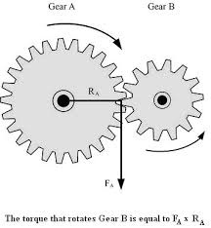
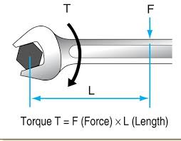
Torque

Slide 32
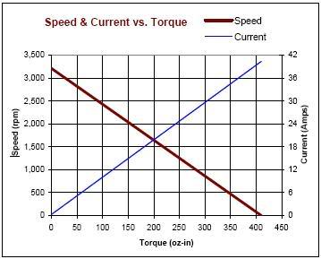
Torque VS Current

Slide 33
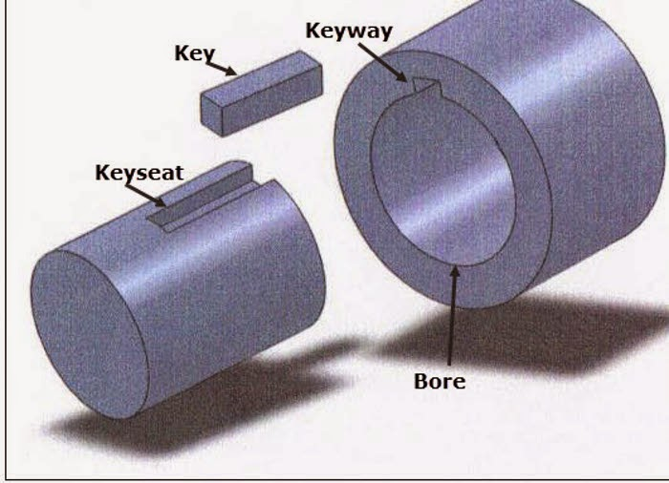
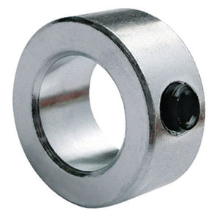
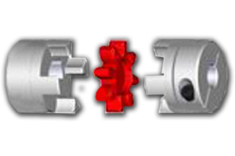
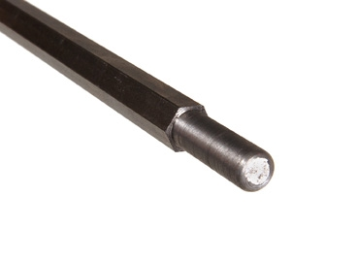
Shaft Connections

Slide 34
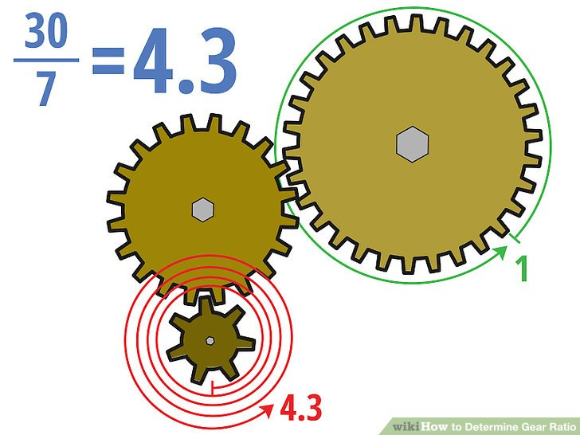
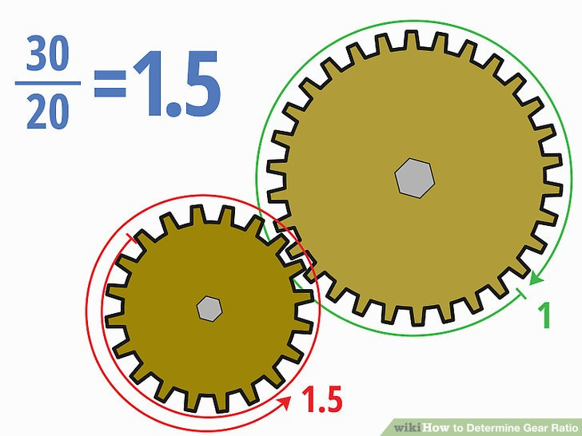
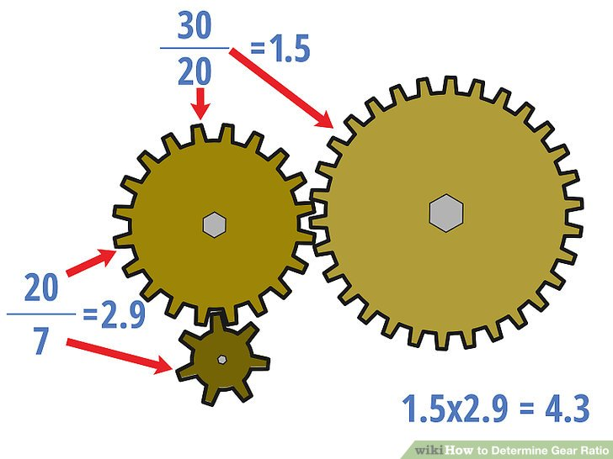
Gearing

Slide 35
Challenge - let’s specify a motor
Robot + payload = 50 lbs
I want to go up at least a 10 degree incline
I want to go at least walking speed (3.1 mph)
Accelerate to its speed within 2 seconds
We’ll use 10 inch wheels

Slide 36
WARNING
not overwhelming math ahead

Slide 37
The Formulas
P = I * V
T = F * r
vf = a * t + v0
P = T * ω
F = m * a
g = 30.48 f/s²

Slide 38
Draw a Free Body Diagram
Fr
10 degrees
Fg

Slide 39
Forces happening
Fgy = m * g * cos(Θ)
Fgx = m * g * sin(Θ)
Fr = Force from motor
Fr
10 degrees
Fg

Slide 40
We must overcome!
Fr - Fgx = Ftotal
(T/r) - m*g*sin(Θ) = m*a
T/r = m*a + m*g*sin(Θ)
T = m*(a+g*sin(Θ))*r
Fgx = m * g * sin(Θ)
T = Fr * r
T/r = Fr

Slide 41
Convert Requirements (trust me)
Freedom Units | Sensible Metric Units
50 lbs | 22.680 kg
3.1 mph | 1.38 m/s
Gravity | 9.8 m/s²
10” wheels | 0.254 meter wheels

Slide 42
He Did The Math
T = m*(a+g*sin(Θ))*r
T = 22.68 * (a + 9.8 * sin(10)) * 0.254
T = 22.68 * (0.69 + 9.8 * sin(10)) * 0.254
T = 22.68 * (0.69 + 1.702) * 0.254
T = 22.68 * 2.392 * 0.254
T = 13.80 Nm
13.80 / 2 = 6.89 Nm
vf = a * t + v0
1.38 m/s = a * 2 + 0
1.38 m/s = 2 * a
a = 0.69 m/s²

Slide 43
Torque conversions
kg/cm | 70.26
oz/in | 975.71
lb/ft | 5.08

Slide 44
RPM to MPH with 10” wheels
100 rpm | 2.98 MPH
250 rpm | 7.45 MPH
500 rpm | 14.88
1000 rpm | 29.8 MPH

Slide 45
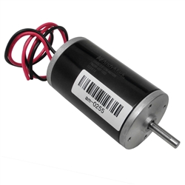
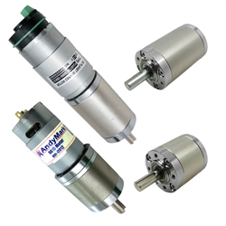



Motor Shopping
 | http://www.andymark.com/CIM-Motor-p/am-0255.htm | $28 | 2655 rpm | 172 oz-in
 | http://www.andymark.com/product-p/am-pgseries.htm | $55 | 75 rpm | 6335 oz-in
 | http://www.andymark.com/NeveRest-p/am-neverest.htm | $28 | 105 rpm | 593 oz-in
 | http://www.robotmarketplace.com/products/0-pdx26.html | $85 | 900 rpm | 2320 oz-in
 | http://www.robotmarketplace.com/products/0-e30-150.html | $79 | 5600 rpm | 710 oz-in

Slide 46
But what if we geared down…?
2655 rpm @ 10 inches = 79.8 mph!!!
Geared down 10:1:
265.5 rpm @ 10 inches = 7.9 mph
...also giving us 1720 oz/in!

Slide 47
Wait a minute… what’s stall torque anyway?
… and no-load rpm?
… and efficiency?

Slide 48
Places to shop
Andy Mark - http://www.andymark.com
Robot Marketplace - http://www.robotmarketplace.com
Robot Shop - http://www.robotshop.com
Trossen Robotics - http://www.trossenrobotics.com
Super Droid Robots - https://superdroidrobots.com

Slide 49
Questions?

